Slide 1
CS161 Discussion 4 CSP
Jinghao Zhao
10/30/2020

Slide 2
Constraint Satisfaction Problems (CSP)
CSP = {V, D, C}
Variables: V = {V1 ,..,VN }
Example: The values of the nodes in the graph
Domain: The set of d values that each variable can take
Example: D = {R, G, B}
Constraints: C = {C1 ,..,CK }
Each constraint consists of a tuple of variables and a list of values that the tuple is allowed to take for this problem
Example: [(V2 ,V3 ),{(R,B),(R,G),(B,R),(B,G),(G,R),(G,B)}]
Constraints are usually defined implicitly: A function is defined to test if a tuple of variables satisfies the constraint
Example: Vi ≠ Vj for every edge (i,j)

Slide 3
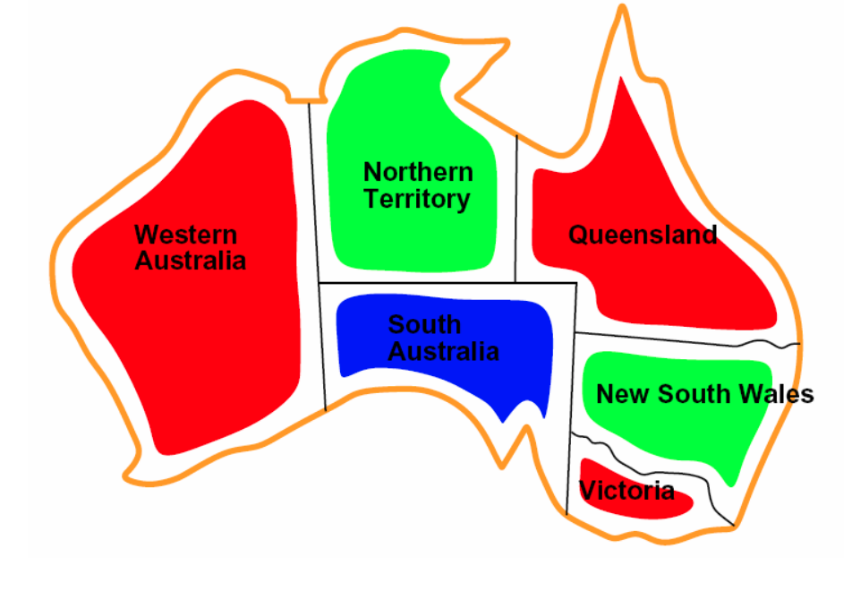
Canonical Example: Graph Coloring

Slide 4
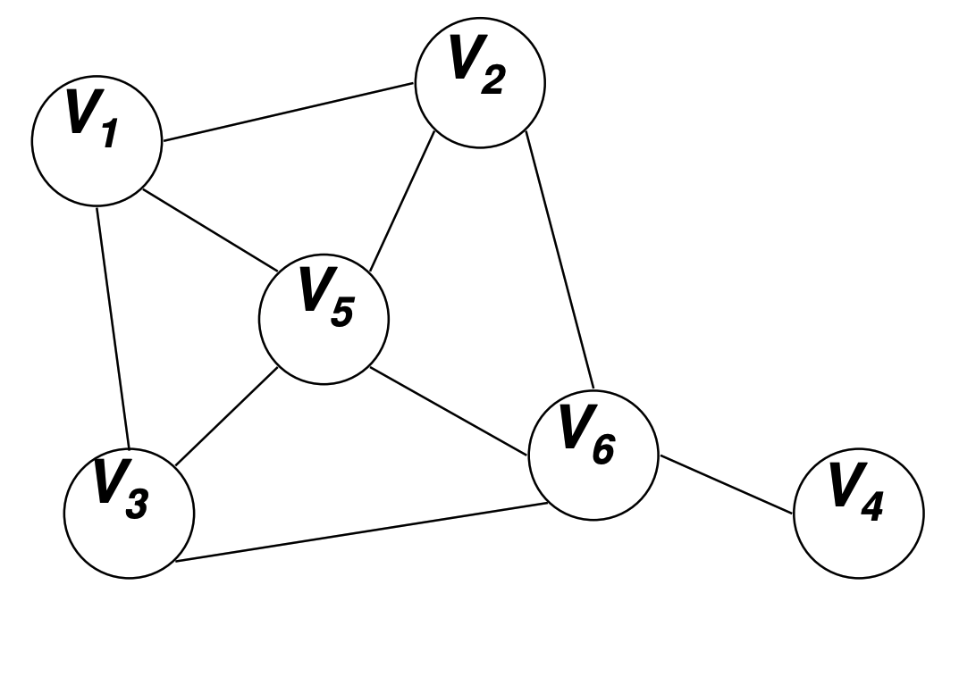
Canonical Example: Graph Coloring
Consider N nodes in a graph
Assign values V1 ,..,VN to each of the N nodes
The values are taken in {R,G,B}
Constraints: If there is an edge between i and j, then Vi must be different of Vj

Slide 5
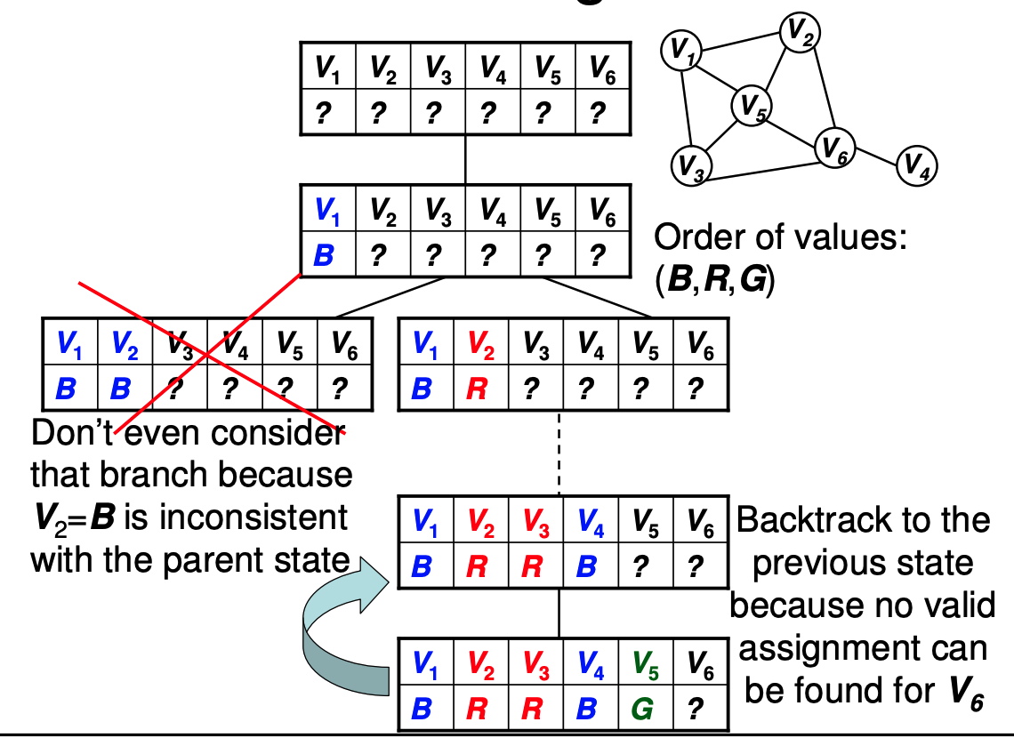
Backtrack search

Slide 6
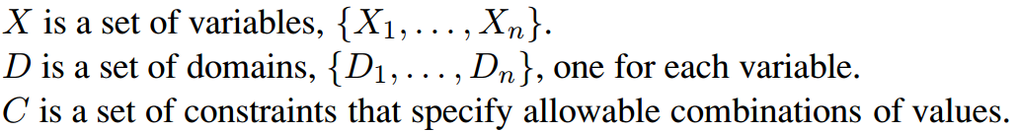
Constraint Satisfaction Problem
A state in CSP: an assignment of values to some or all variables
Consistent/Legal assignment: an assignment that does not violate any constraints
Complete assignment: every variable is assigned (otherwise partial assignment)
A solution in CSP: a consistent, complete assignment
Notes:
Each domain Di consists of a set of allowable values, {v1, . . . , vk} for variable Xi. Each constraint Ci consists of a pair scope, rel, where scope is a tuple of variables that participate in the constraint and rel is a relation that defines the values that those variables can take on
(X1, X2), X1 = X2

Slide 7
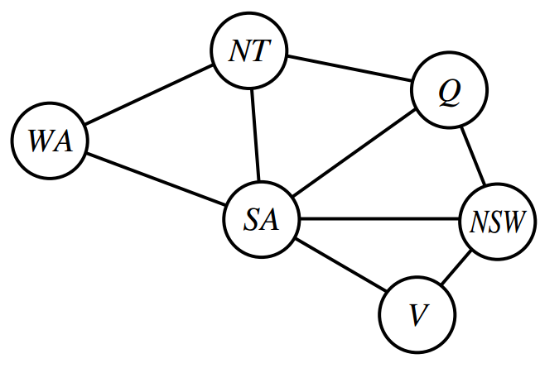
Constraint Graph

Slide 8
Exercise – CSP Formulations
Class scheduling
A fixed number of professors
A fixed number of classrooms
A list of classes to be offered
A list of possible time slots for classes.
Each professor has a set of classes that he or she can teach.
Notes:
For class scheduling, one possibility is to have three variables for each class, one with times for values (e.g. MWF8:00, TuTh8:00, MWF9:00, ...), one with classrooms for values (e.g. Wheeler110, Evans330, ...) and one with instructors for values (e.g. Abelson, Bibel, Canny, ...). Constraints say that only one class can be in the same classroom at the same time, and an instructor can only teach one class at a time. There may be other constraints as well (e.g. an instructor should not have two consecutive classes)

Slide 9
Exercise – CSP Formulations
Hamiltonian tour
Given a network of cities connected by roads, choose an order to visit all cities in a country without repeating any.
Notes:
one possibility is to have one variable for each stop on the tour, with binary constraints requiring neighboring cities to be connected by roads, and an AllDiff constraint that all variables have a different value

Slide 10
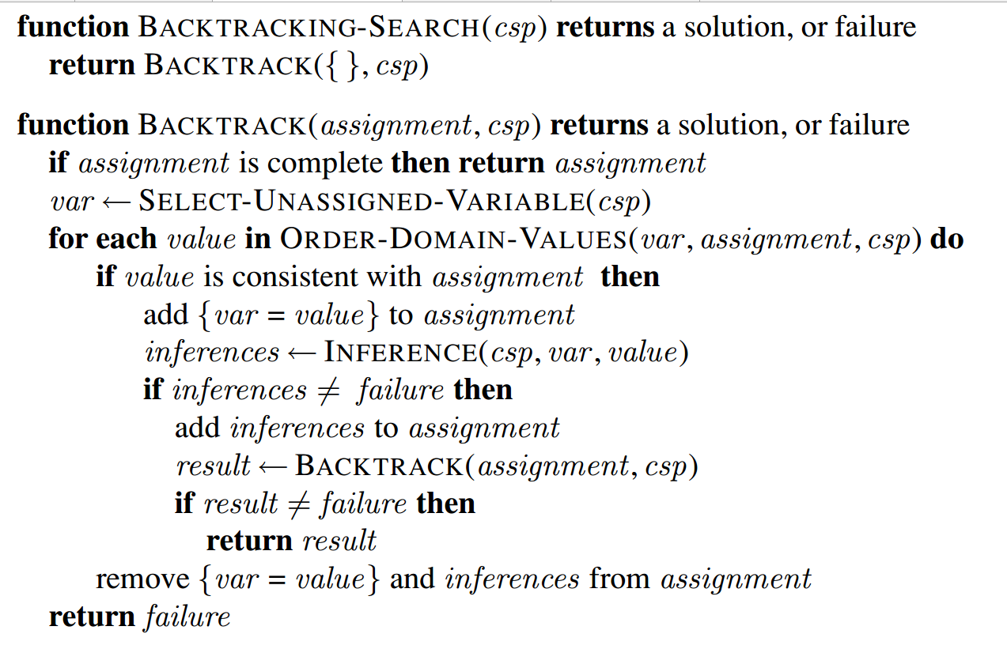
Main Algorithm for CSP - Backtracking DFS
Backtrack

Slide 11
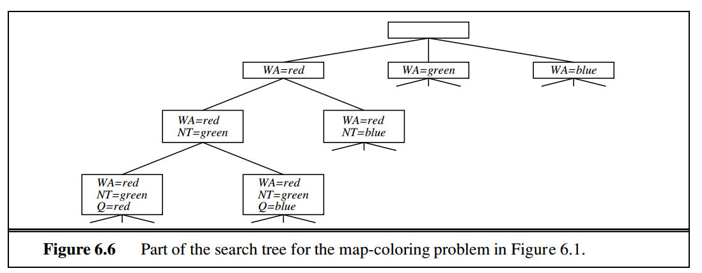
Main Algorithm for CSP - Backtracking DFS
When to backtrack?
When a variable has no legal values left to assign (No possible consistent assignment)

Slide 12
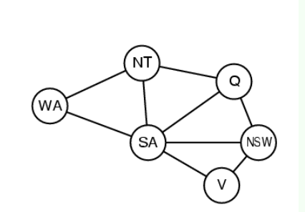
Variable and Value Ordering
Backtracking DFS:
Choose a variable and assign a value.
Backtrack when no legal values left.
Keep trying until it fails
How to select unassigned variable?
In order what should its values be tried?
Notes:
If some variable X has no legal values left, the MRV heuristic will select X and failure will be detected immediately—avoiding pointless searches through other variables.
The MRV heuristic doesn’t help at all in choosing the first region to color in Australia, DEGREE HEURISTIC because initially every region has three legal colors.

Slide 13
Variable and Value Ordering
How to select unassigned variable?
Minimum-remaining-values (MRV) heuristic
a.k.a. "most constrained variable", or "fail-first"
If no legal values left, fail immediately
Degree heuristic
Pick variable with most constraints on remaining variables
Attempt to reduce branching factor on future choice
Useful as a tie-breaker
In order what should its values be tried?
Least-constraining-value
Leave the maximum flexibility for subsequent variable assignments
Notes:
If some variable X has no legal values left, the MRV heuristic will select X and failure will be detected immediately—avoiding pointless searches through other variables.
The MRV heuristic doesn’t help at all in choosing the first region to color in Australia, DEGREE HEURISTIC because initially every region has three legal colors.

Slide 14
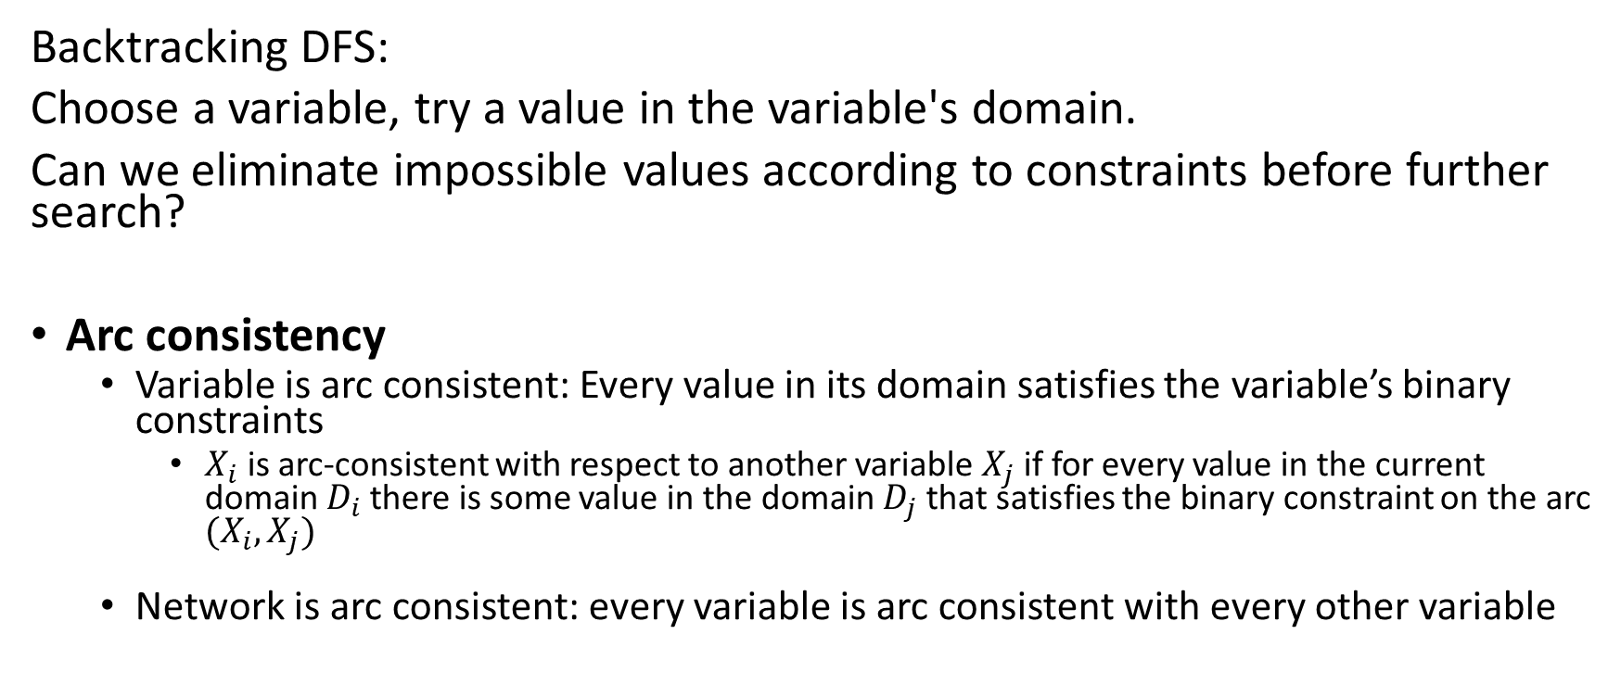
Arc Consistency
Backtracking DFS:
Choose a variable, try a value in the variable's domain.
Can we eliminate impossible values according to constraints before further search?
Arc consistency
Variable is arc consistent: Every value in its domain satisfies the variable’s binary constraints
$X_{i}$ is arc-consistent with respect to another variable $X_{j}$ if for every value in the current domain $D_{i}$ there is some value in the domain $D_{j}$ that satisfies the binary constraint on the arc $(X_{i}, X_{j})$
Network is arc consistent: every variable is arc consistent with every other variable
Notes:
Node consistency:
For example, in the variant of the Australia map-coloring problem (Figure 6.1) where South Australians dislike green, the variable SA starts with domain {red, green, blue}, and we can make it node consistent by eliminating green, leaving SA with the reduced domain {red, blue}. We say that a network is node-consistent if every variable in the network is node-consistent.

Slide 15

Example – Arc Consistency
The domain of both X and Y is the set of digits (0~9).
$Y=X^{2}$
What will the domains of X and Y be after enforcing arc consistency?
Notes:
To make X arc-consistent with respect to Y , we reduce X’s domain to {0, 1, 2, 3}. If we also make Y arc-consistent with respect to X, then Y ’s domain becomes {0, 1, 4, 9} and the whole CSP is arc-consistent

Slide 16
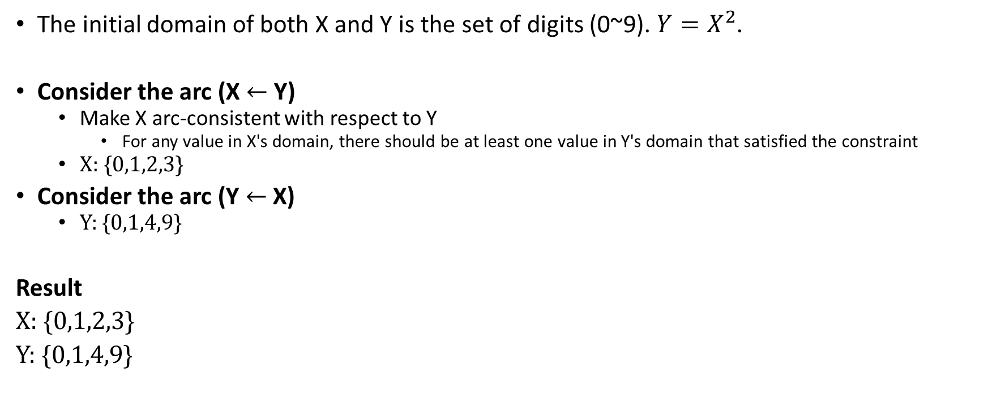
Example – Arc Consistency
The initial domain of both X and Y is the set of digits (0~9). $Y=X^{2}$.
Consider the arc (X $←$ Y)
Make X arc-consistent with respect to Y
For any value in X's domain, there should be at least one value in Y's domain that satisfied the constraint
X: {0,1,2,3}
Consider the arc (Y $←$ X)
Y: {0,1,4,9}
Result
X: {0,1,2,3}
Y: {0,1,4,9}
Notes:
To make X arc-consistent with respect to Y , we reduce X’s domain to {0, 1, 2, 3}. If we also make Y arc-consistent with respect to X, then Y ’s domain becomes {0, 1, 4, 9} and the whole CSP is arc-consistent

Slide 17
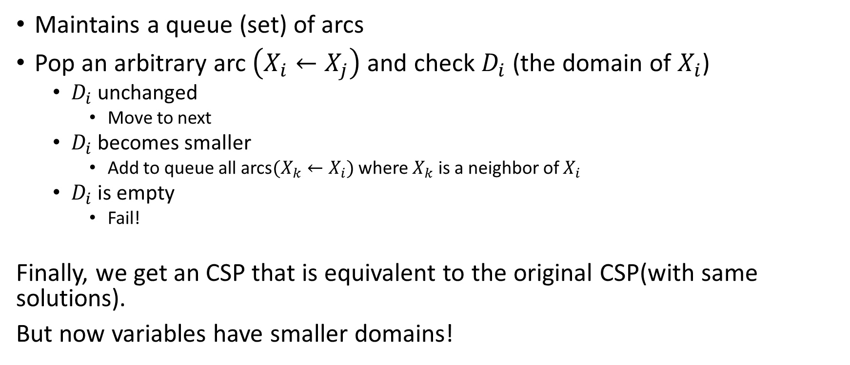
Arc Consistency Algorithm: AC-3
Maintains a queue (set) of arcs
Pop an arbitrary arc $\left(X_{i}←X_{j}\right)$ and check $D_{i}$ (the domain of $X_{i}$)
$D_{i}$ unchanged
Move to next
$D_{i}$ becomes smaller
Add to queue all arcs$(X_{k}←X_{i})$ where $X_{k}$ is a neighbor of $X_{i}$
$D_{i}$ is empty
Fail!
Finally, we get an CSP that is equivalent to the original CSP(with same solutions).
But now variables have smaller domains!
Notes:
The change in Di might enable further reductions in the domains of Dk, even if we have previously considered Xk

Slide 18
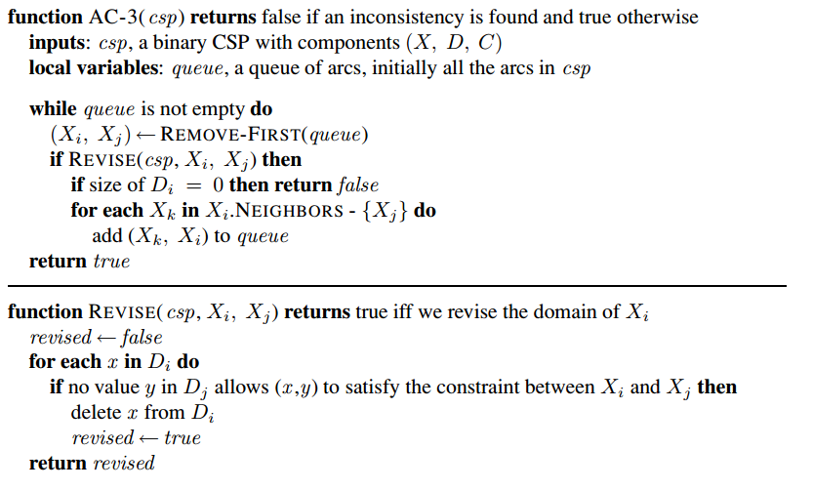
Arc Consistency Algorithm: AC-3
Notes:
The most popular algorithm for arc consistency is called AC-3 (see Figure 6.3). To make every variable arc-consistent, the AC-3 algorithm maintains a queue of arcs to consider. (Actually, the order of consideration is not important, so the data structure is really a set, but tradition calls it a queue.)

Slide 19
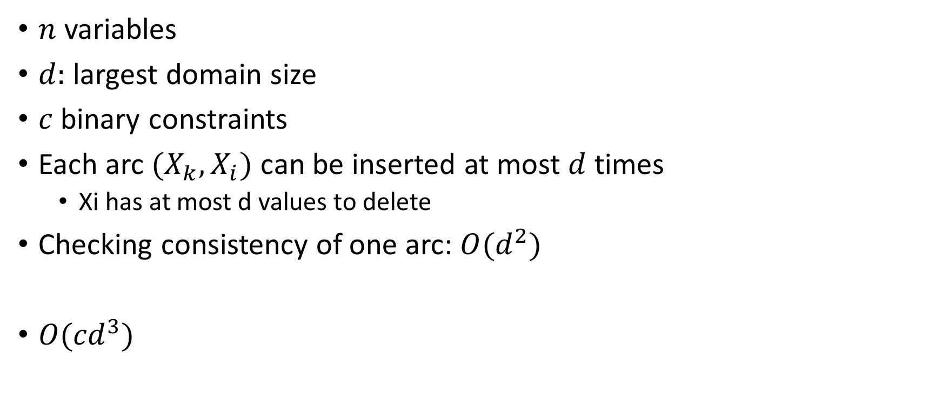
Complexity of AC-3
$n$ variables
$d:$ largest domain size
$c$binary constraints
Each arc $(X_{k}, X_{i})$ can be inserted at most $d$ times
Xi has at most d values to delete
Checking consistency of one arc: $O(d^{2})$
$O({cd}^{3})$

Slide 20
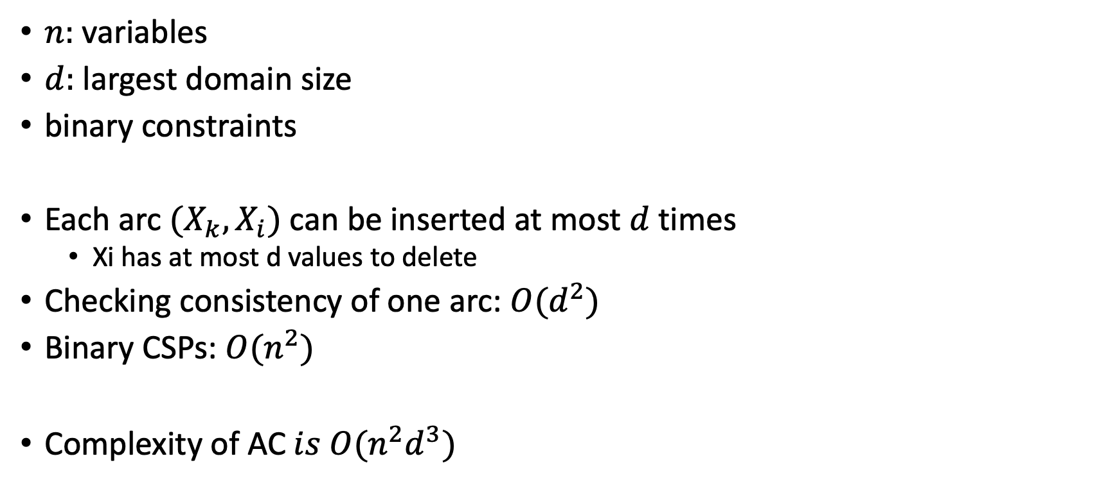
Complexity of AC (binary constraints)
$n:$ variables
$d:$ largest domain size
binary constraints
Each arc $(X_{k}, X_{i})$ can be inserted at most $d$ times
Xi has at most d values to delete
Checking consistency of one arc: $O(d^{2})$
Binary CSPs: $O(n^{2})$
$\text{Complexity} \text{of} \text{AC} is O({n^{2}d}^{3})$

Slide 21
Maintaining Arc Consistency (MAC)
After assigning a value to a variable, we can use either of the following algorithm to eliminate impossible values before next round's search starts:
Forward checking only makes current variable arc-consistent
MAC maintains global arc consistency
Notes:
Time complexity: O(n2d3)

Slide 22
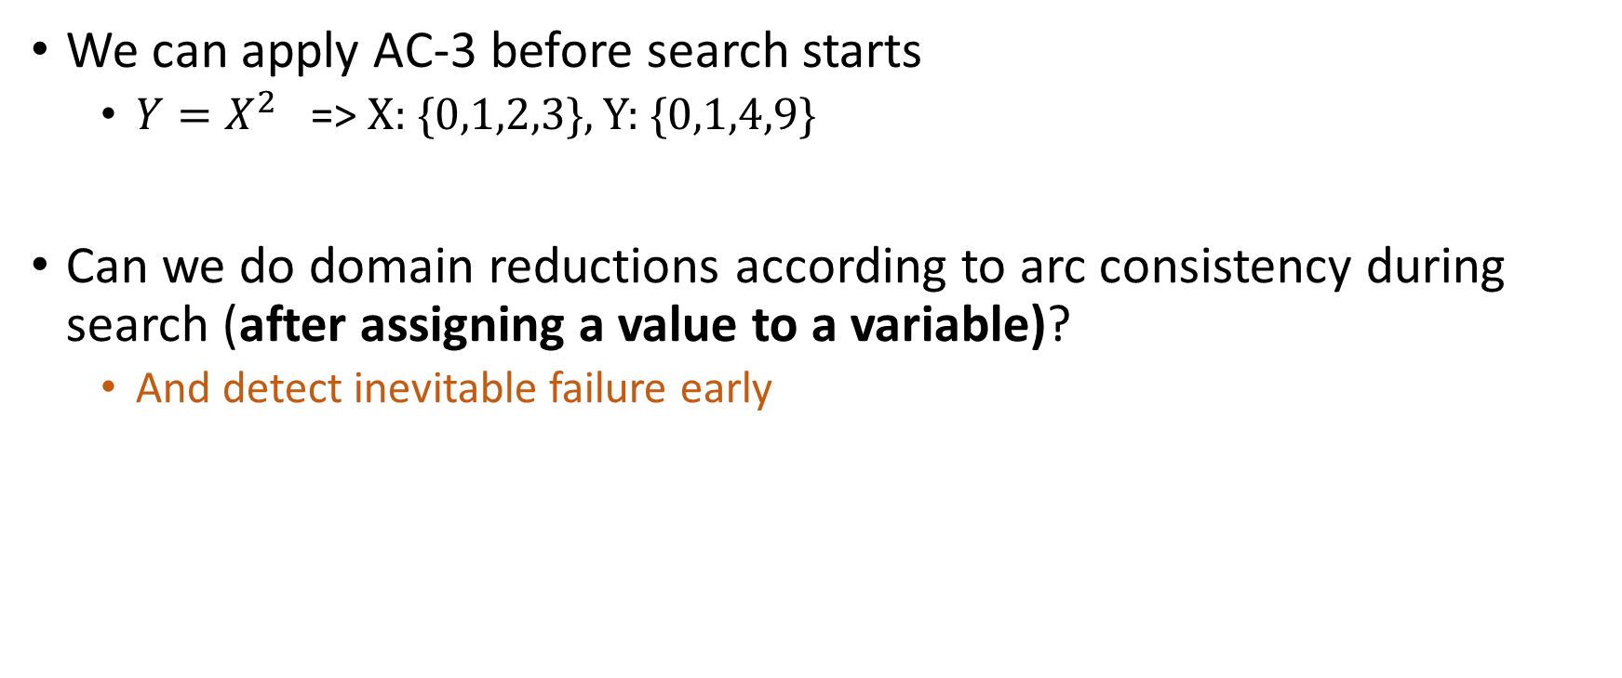
Forward Checking and MAC
We can apply AC-3 before search starts
$Y=X^{2}$ => X: {0,1,2,3}, Y: {0,1,4,9}
Can we do domain reductions according to arc consistency during search (after assigning a value to a variable)?
And detect inevitable failure early

Slide 23
Forward Checking and MAC
After assigning a value to a variable, we can
Forward Checking
Maintaining Arc Consistency (MAC)
Difference between Forward Checking and MAC:
Which arcs to check?

Slide 24
Forward Checking
Which arcs to check after assigning a value to variable X?
Only the arcs of X
Forward Checking
Keep track of remaining legal values for unassigned variables that are connected to current variable. (Variable-level arc consistency)
Terminates when any variable has no legal values
Then backtrack!

Slide 25
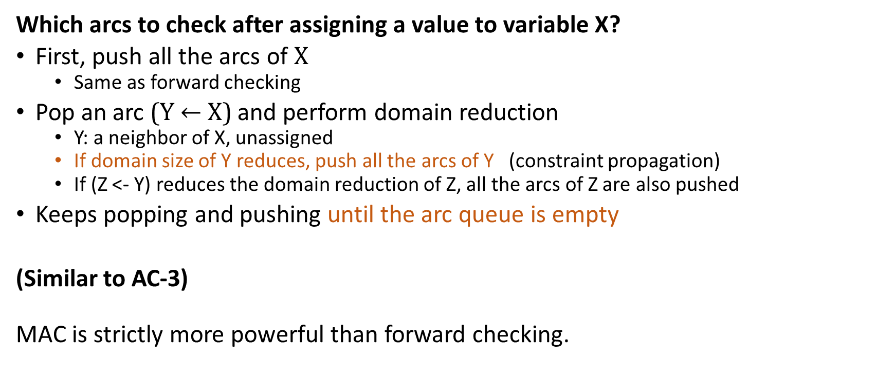
Maintaining Arc Consistency (MAC)
Which arcs to check after assigning a value to variable X?
First, push all the arcs of X
Same as forward checking
Pop an arc (Y $←$ X) and perform domain reduction
Y: a neighbor of X, unassigned
If domain size of Y reduces, push all the arcs of Y (constraint propagation)
If (Z <- Y) reduces the domain reduction of Z, all the arcs of Z are also pushed
Keeps popping and pushing until the arc queue is empty
(Similar to AC-3)
MAC is strictly more powerful than forward checking.
Notes:
Time complexity: O(n2d3)
Xj <- Xi

Slide 26
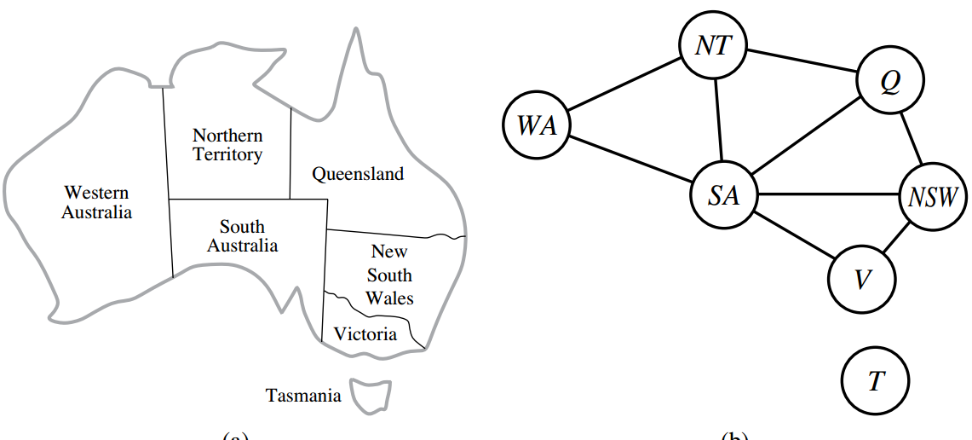
Exercise
Use the AC-3 algorithm to show that arc consistency can detect the inconsistency of the partial assignment {WA = green, V = red}

Slide 27
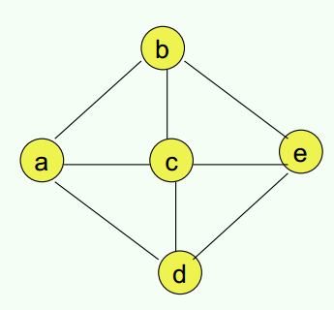
Exercise – Solve CSP
The domain for every variable is [1,2,3,4].
2 unary constraints: - variable “a” cannot take values 3 and 4. - variable “b” cannot take value 4.
Variables connected by an edge cannot have the same value.
========================
Heuristics:
========================
Find solution for this CSP. Show each step and explain.
Notes:
How many binary constraints? 8.
MVH→ a=1 (for example) FC+MVH→ b=2 FC+MVH→ c=3 FC+MVH→ d=4 FC→ e=1

Slide 28
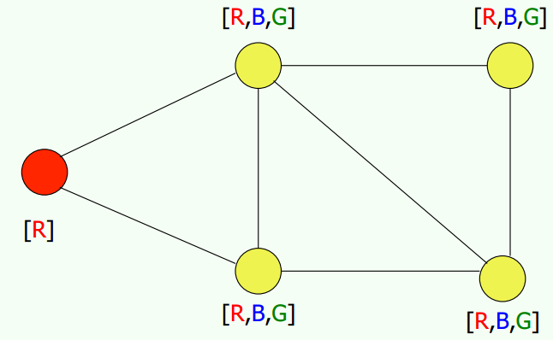
Exercise – Solve CSP
Connected variables cannot share color
Solve this CSP and explain each step
Use all heuristics

Slide 29
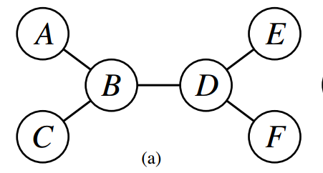
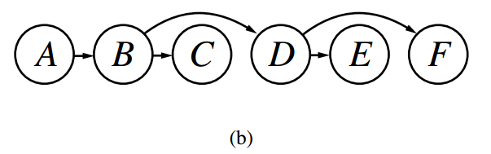

Tree-structured CSP
Tree-structured CSP could be solved in time linear in # of variables
Method: Topological sorting
Assign values to variable in order
No need to backtrack!
Time Complexity: $O(nd^{2})$

Slide 30
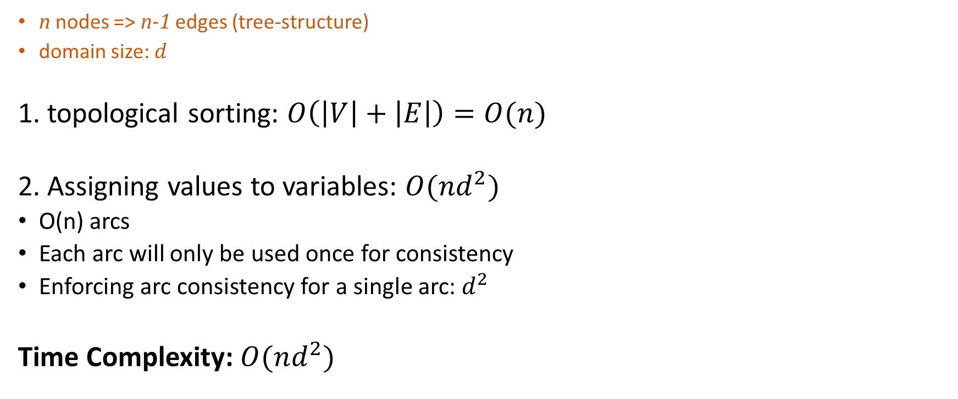
Tree-structured CSP
n nodes => n-1 edges (tree-structure)
domain size: $d$
1. topological sorting: $O\left(\left|V\right|+\left|E\right|\right)=O(n)$
2. Assigning values to variables: $O(nd^{2})$
O(n) arcs
Each arc will only be used once for consistency
Enforcing arc consistency for a single arc: $d^{2}$
Time Complexity: $O(nd^{2})$

Slide 31
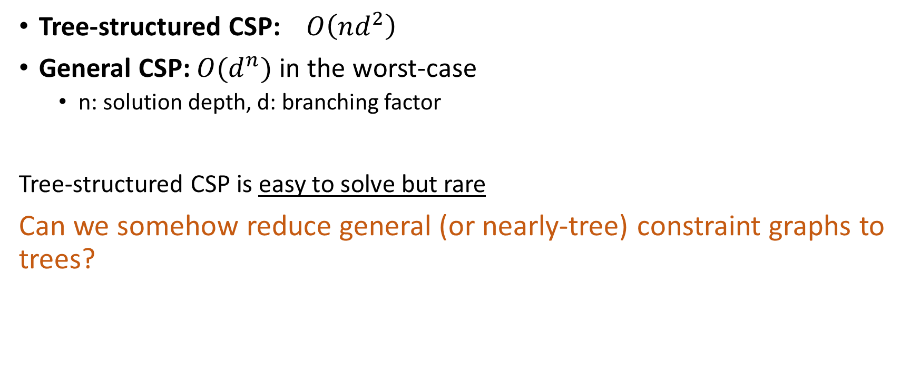
Reduce general CSP to tree-structured CSP
Tree-structured CSP: $O\left(nd^{2}\right)$
General CSP: $O(d^{n})$ in the worst-case
n: solution depth, d: branching factor
Tree-structured CSP is easy to solve but rare
Can we somehow reduce general (or nearly-tree) constraint graphs to trees?

Slide 32
Reduce general CSP to tree-structured CSP
Methods:
Cutset conditioning
Assign values to some variables so that the remaining variables form a tree
Tree decomposition
Decompose the original problem into a set of connected subproblems

Slide 33
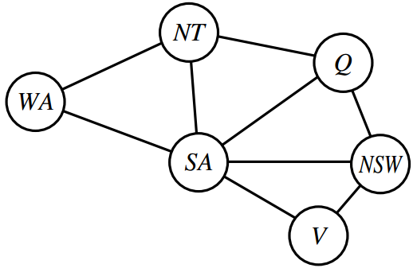
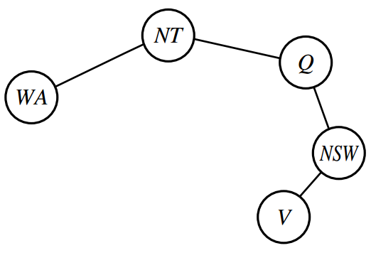
Cutset Conditioning
Assign values to some variables so that the remaining variables form a tree
Cycle cutset: a set of variables. Removing the set of variables and graphs will have no cycle
Conditioning: Assign values to certain variables and prune neighbors' domains
[B,G]
[B,G]
[B,G]
[B,G]
[B,G]

Slide 34
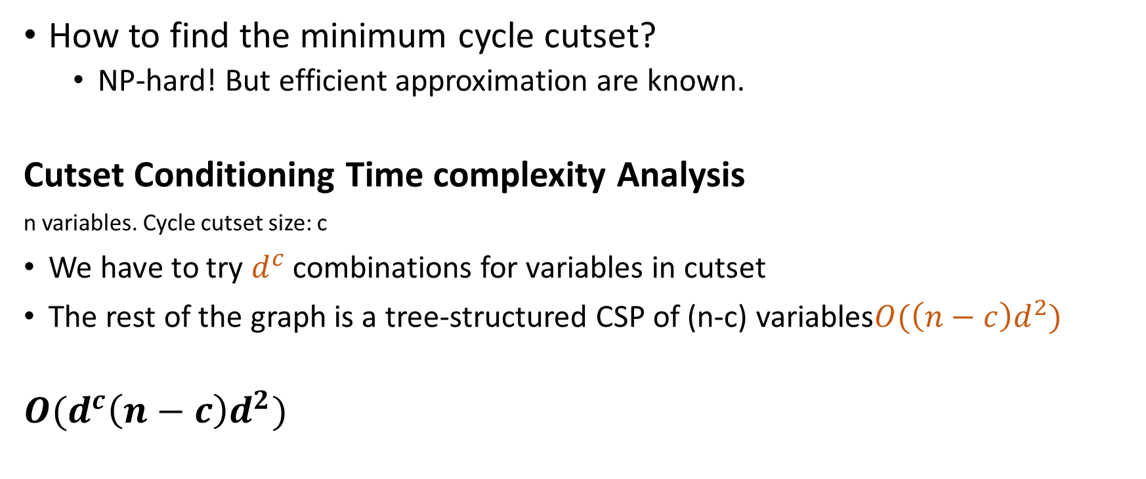
Cutset Conditioning
How to find the minimum cycle cutset?
NP-hard! But efficient approximation are known.
Cutset Conditioning Time complexity Analysis
n variables. Cycle cutset size: c
We have to try $d^{c}$ combinations for variables in cutset
The rest of the graph is a tree-structured CSP of (n-c) variables$O(\left(n−c\right)d^{2})$
$$O(d^{c}\left(n−c\right)d^{2})$$

Slide 35
Tree Decomposition
Decompose the original problem into a set of connected subproblems
Every variable in the original problem appears in at least one of the subproblems.
If two variables are connected by a constraint in the original problem, they must appear together (along with the constraint) in at least one of the subproblems.
If a variable appears in two subproblems in the tree, it must appear in every subproblem along the path connecting those subproblems.

Slide 36
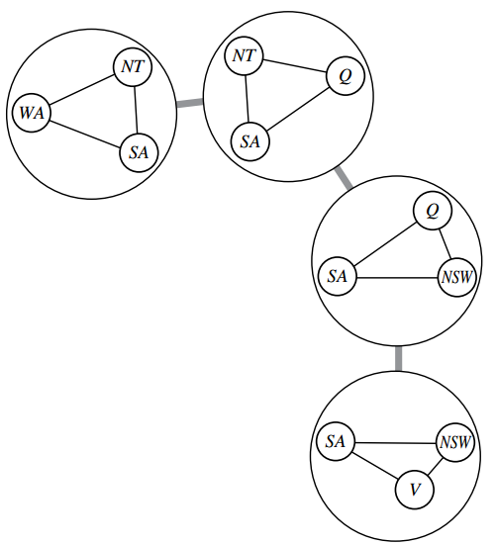
Tree Decomposition
Every variable in the original problem appears in at least one of the subproblems.
If two variables are connected by a constraint in the original problem, they must appear together (along with the constraint) in at least one of the subproblems.
If a variable appears in two subproblems in the tree, it must appear in every subproblem along the path connecting those subproblems.

Slide 37
Tree Decomposition
Each subproblem is a "mega-variable"
Domain: all the solutions to the subproblem
Constraints between subproblems:
Subproblem solutions agree on their shared variables.
Notes:
The subproblem's domain is the set of all the solutions to the subproblem

Slide 38
Tree Decomposition
A constraint graph may correspond to multiple tree decomposition
When choosing the decomposition, make the subproblems as small as possible

